Slide 1
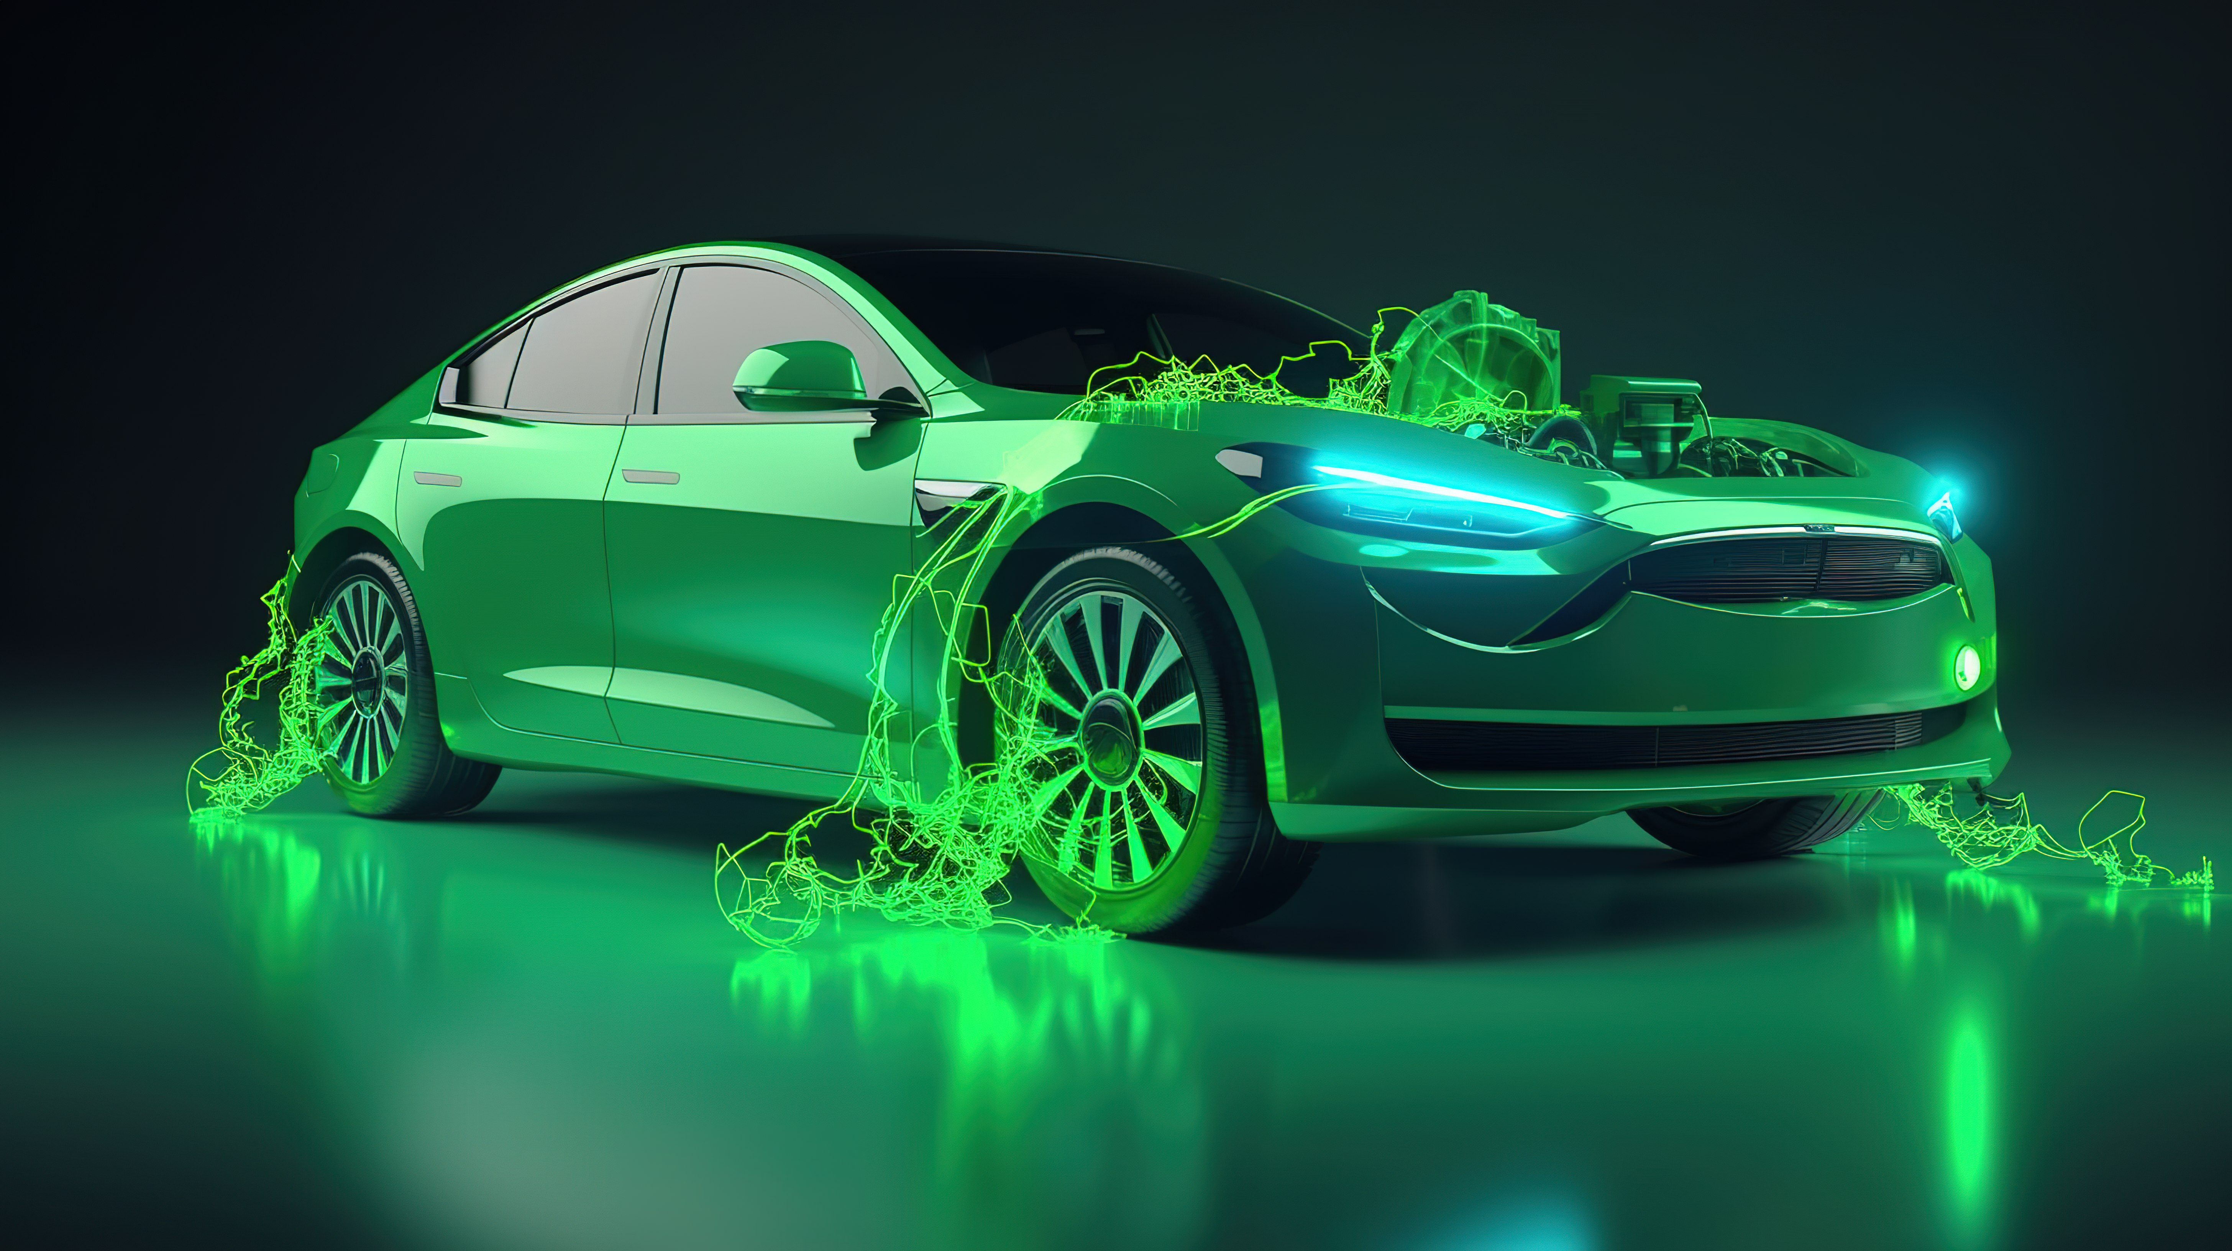


Slide 2
How many of you believe that electric vehicles will dominate the Indian roads in the next five years?`

Slide 3


Slide 4


ELECTRIC VEHICLE ADOPTION IN INDIA
CHALLENGE #12
BY
VEENA CHANDRA

Slide 5
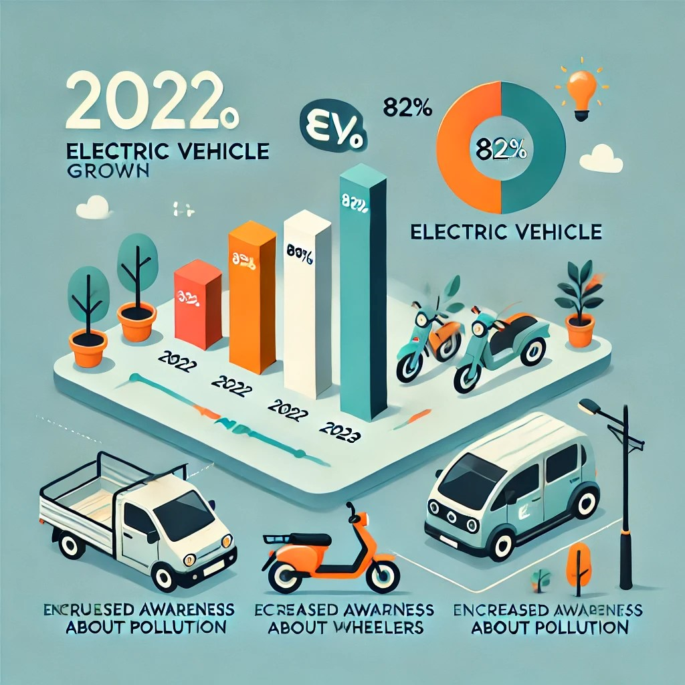
Some major points on EV of Indian market
Rapid Growth in EV Adoption:
Changing Public Perception
Substantial Sales Growth
Availability
Dominance of Electric Two-Wheelers

Slide 6
The three approach of solving this project
Why
what
How

Slide 7
PROJECT DESCRIPTION
AtliQ Motors, a leading EV manufacturer from the USA, plans to expand into India, where their market share is currently less than 2%. To inform their strategy, Bruce Haryali, head of AtliQ Motors India, commissioned a detailed market study.
Data analyst Peter Pandey analyzed sales data by vehicle makers and state-wise sales data, focusing on trends, revenue growth, and the impact of government incentives. Key performance indicators (KPIs) such as total EV sales, revenue, sales growth rate, and penetration rate were measured.
The analysis revealed significant sales growth influenced by state-specific incentives, identified peak and low sales seasons, and projected future sales growth. This study provides critical insights for AtliQ Motors' market entry and expansion strategy in India

Slide 8
DATA SOURCES
Description of the datasets used (maker and state datasets)
electric_vehicle_sales_by_state.csv--- date: (dd-mm-yy),state: State, vehicle_category: 2W or 4W,electric_vehicles_sold: EVs sold, total_vehicles_sold: Total vehicles sold,
electric_vehicle_sales_by_makers.csvdate: (dd-mmm-yy),vehicle_category: 2W or 4Wmaker: Manufacture,relectric_vehicles_sold: EVs sold
dim_date.csvdate: (dd-mmm-yy),fiscal_year: Fiscal year,quarter: Quarter (Q1, Q2, Q3, Q4)

Slide 9
Data Sources and Methodology
Data was collected from various sources, including sales data by vehicle makers and state-wise sales data.
We focused on key performance indicators (KPIs) such as total EV sales, revenue, sales growth rate, and penetration rate.
Analysis was conducted to understand the impact of state-specific incentives and identify seasonal sales trends.

Slide 10
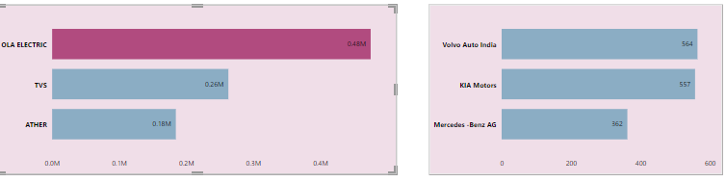
1. List the top 3 and bottom 3 makers for the fiscal years 2023 and 2024 in terms of the number of 2-wheelers sold

Slide 11
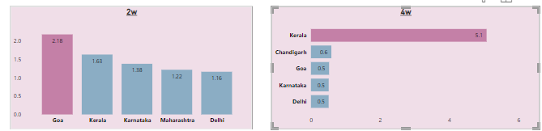
2.Identify the top 5 states with the highest penetration rate in 2-wheeler and 4-wheeler EV sales in FY 2024

Slide 12
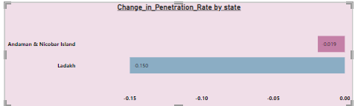
3.List the states with negative penetration (decline) in EV sales from 2022 to 2024?

Slide 14
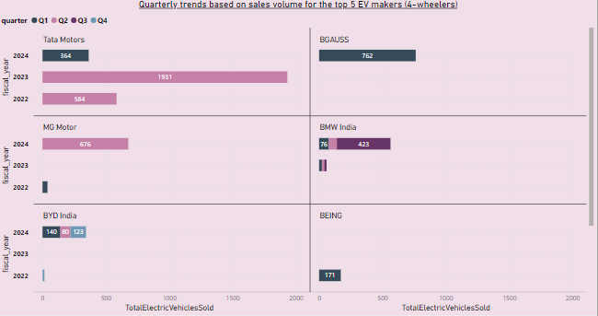
4.What are the quarterly trends based on sales volume for the top 5 EV makers (4-wheelers) from 2022 to 2024?

Slide 15
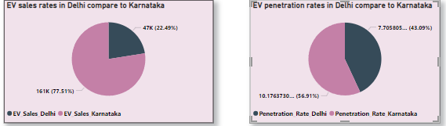
5.How do the EV sales and penetration rates in Delhi compare to Karnataka for 2024?

Slide 16
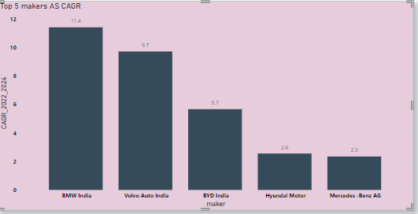
6. List down the compounded annual growth rate (CAGR) in 4-wheeler units for the top 5 makers from 2022 to 2024.

Slide 17
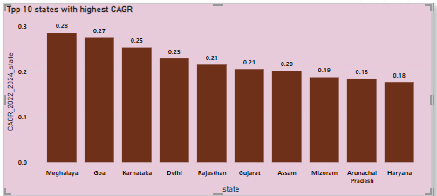
7. List down the top 10 states that had the highest compounded annual growth rate (CAGR) from 2022 to 2024 in total vehicles sold.

Slide 18
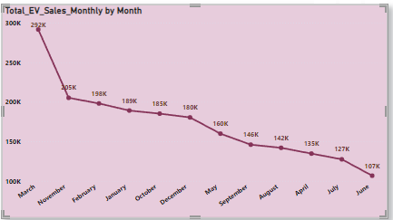
8.What are the peak and low season months for EV sales based on the data from 2022 to 2024?

Slide 19
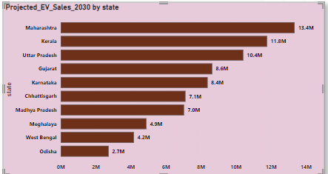
9.What is the projected number of EV sales (including 2-wheelers and 4- wheelers) for the top 10 states by penetration rate in 2030, based on the compounded annual growth rate (CAGR) from previous years

Slide 20
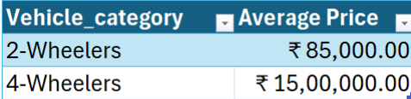
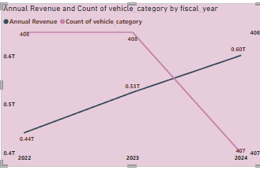
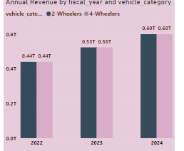
10. Estimate the revenue growth rate of 4-wheeler and 2-wheelers EVs in India for 2022 vs 2024 and 2023 vs 2024, assuming an average unit price. H

Slide 21
Secondary Research question
What are the primary reasons for customers choosing 4-wheeler EVs in 2023 and 2024 (cost savings, environmental concerns, government incentives)?
Government incentives and subsidies significantly impact the adoption rates of two-wheelers and four-wheelers by reducing initial costs and making them more financially accessible. States like Delhi, Maharashtra, Karnataka, Tamil Nadu, Telangana, and Gujarat have been at the forefront of offering substantial subsidies. For instance, in Maharashtra, a ₹50,000 subsidy for four-wheeler electric vehicles has greatly influenced purchasing decisions, resulting in higher sales.”
.

Slide 22
How do government incentives and subsidies impact the adoption rates of 2-wheelers and 4-wheelers? Which states in India provided most subsidies?
Government incentives and subsidies play a crucial role in increasing the adoption rates of 2-wheelers and 4-wheelers by reducing initial costs and making them more financially accessible. These financial supports drive higher market demand and promote the adoption of eco-friendly vehicles like electric vehicles (EVs). States such as Delhi, Maharashtra, Karnataka, Tamil Nadu, Telangana, and Gujarat have been leading in offering substantial subsidies. Gujarat, in particular, has been notable for its aggressive incentives, contributing to high adoption rates of electric vehicles in the state. These incentives collectively enhance the appeal and accessibility of EVs.

Slide 23
How does the availability of charging stations infrastructure correlate with the EV sales and penetration rates in the top 5 states.
The availability of charging infrastructure is strongly correlated with higher EV sales and penetration rates, as well-developed networks alleviate range anxiety and offer greater convenience. This leads to increased adoption of electric vehicles, particularly in states like Delhi, Maharashtra, Karnataka, Tamil Nadu, and Gujarat. In FY2024, India saw a significant rise in EV sales, reaching 1,752,406 units, marking a 40.31% year-on-year growth. The top five Maharashtra (12.11%), Karnataka (9.66%), Tamil Nadu (5.77%), and Rajasthan (5.61%)—together account for over 50% of the market share. Maharastra is the leading state, underscoring its pivotal role in driving the country's EV adoption.

Slide 24
Who should be the brand ambassador if AtliQ Motors launches their EV/Hybrid vehicles in India and why
MS Dhoni would be an ideal brand ambassador for AtliQ Motors' EV/Hybrid vehicles due to his widespread popularity, trustworthy image, and environmentally conscious lifestyle. Known for his calm, strategic mindset and leadership qualities, Dhoni embodies reliability and innovation—traits that align well with the brand's values of safety and cutting-edge technology. His appeal across various demographics in India can help AtliQ Motors effectively communicate the benefits of electric vehicles, emphasizing sustainability and modern living.

Slide 25
Which state of India is ideal to start the manufacturing unit? (Based on subsidies provided, ease of doing business, stability in governance etc.
Gujarat is ideal for starting a manufacturing unit due to its top ranking with high scores (97.99 in 2015 and 98.3 in 2017), business-friendly policies, and substantial subsidies. The state's stability in governance and very ease of doing business further enhance its attractiveness for new ventures.

Slide 26
Your top 3 recommendations for AtliQ Motors..
Optimize Charging Site Locations: Strategically place charging stations in high-traffic and accessible areas to maximize convenience and address weather-related challenges.
Focus on Battery Service and Support: Ensure reliable battery maintenance and service options to enhance customer satisfaction and vehicle performance.
Adapt to Weather Conditions: Design vehicles and charging infrastructure to withstand various weather conditions, improving durability and reliability across different climates.

Slide 27
THANKS
The dataset is taken from the Vahan Sewa. Thanks to the Vahan Sewa for providing datasets for public access which is a great learning asset

